Slide 1
IT Project Management System - SEP1
Group 4

Slide 2
Project Description
Interview with Mr. Colour
Waterfall approach
Structure

Slide 3
Analysis
List of requirements
Use cases
Activity diagrams
Domain model

Slide 4
Analysis - List of Requirements
Functional Requirements
5 critical priority requirements
12 high priority requirements
4 low priority requirements
Non-Functional Requirements
The JUI should be implemented with Java/JavaFx
The website has to function using Google Chrome, Mozilla Firefox and Safari

Slide 5
Example
Requirement 9
Priority: High
As a product owner I want requirements to automatically get marked with “Ended” when all tasks for a requirement are done, so that I can see what requirements I should be testing.

Slide 6
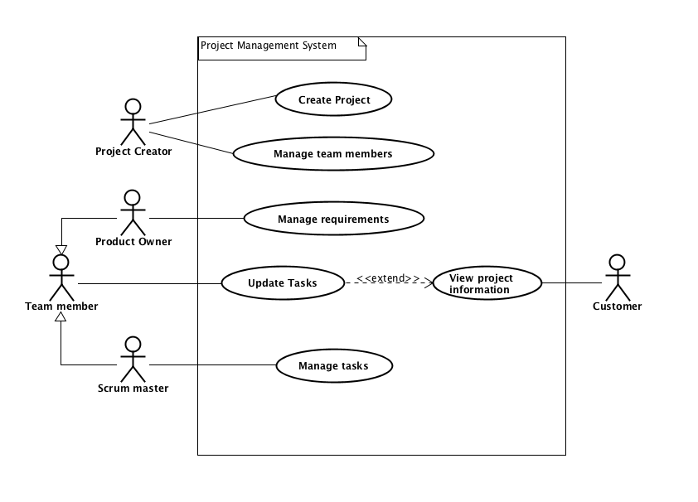
Analysis - Use Cases
Fig. 1. Project Management System - Use Case Diagram

Slide 7
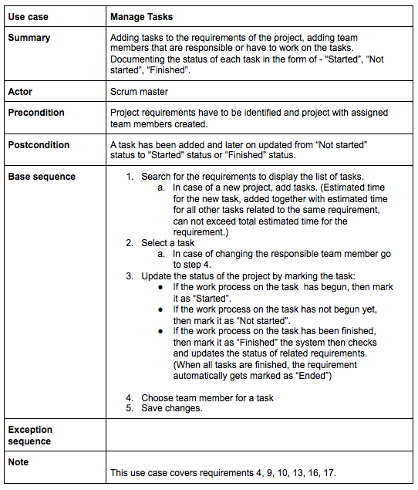
Use Case - Requirement 9
Fig. 3. Manage Tasks - Use Case Description

Slide 8
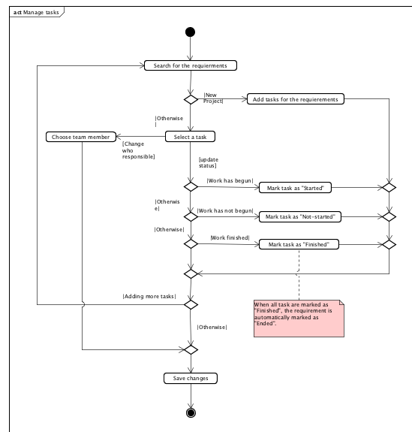
Activity Diagram - Requirement 9
Fig. 5. Manage tasks - Activity diagram

Slide 9
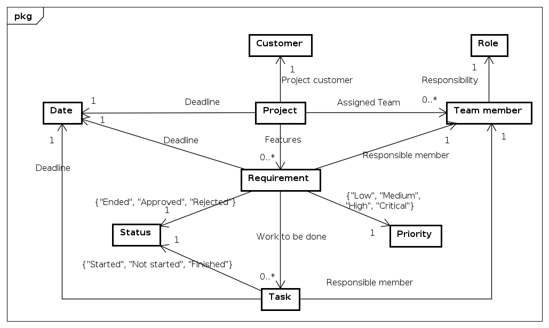
Analysis - Domain Model
Fig. 6. Project Management System - Domain Model

Slide 10
Design
Class diagram
Sequence diagram
GUI views

Slide 11
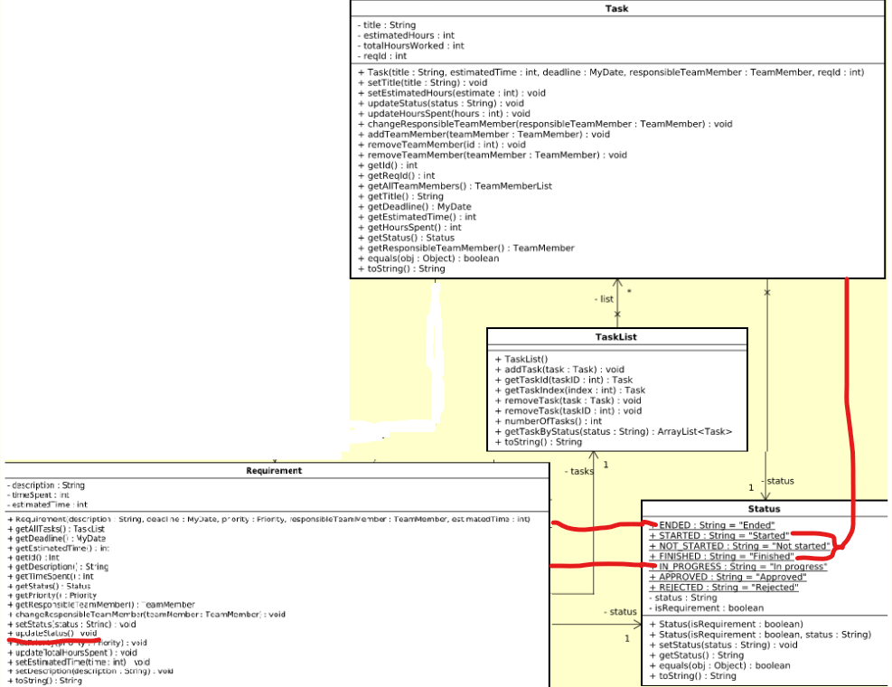
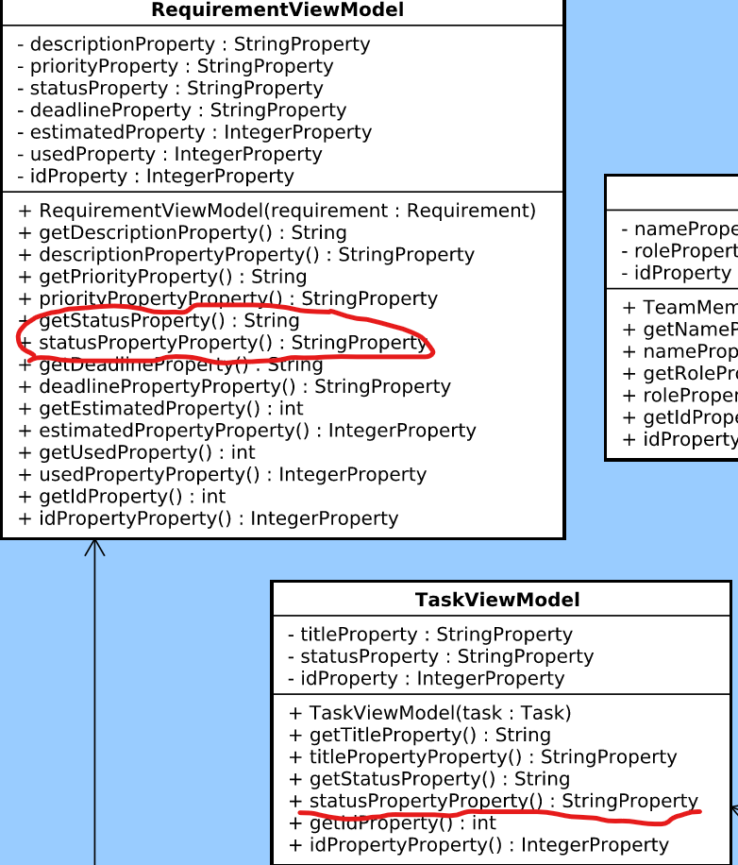
Design - Class diagram - requirement 9.
Fig 5. Part of Class diagram related to updating the requirement status

Slide 12
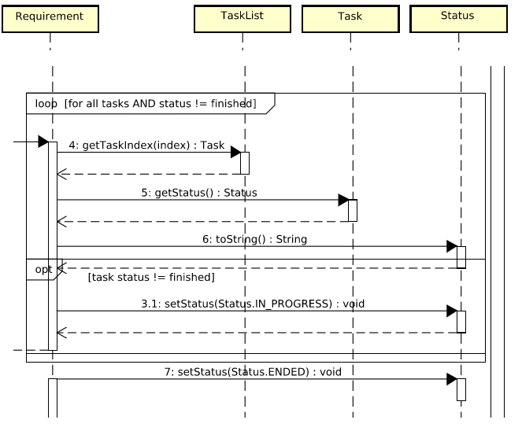
Design - Sequence diagram
Fig 6. Part of the Sequence diagram in regards to updating the requirement status

Slide 13
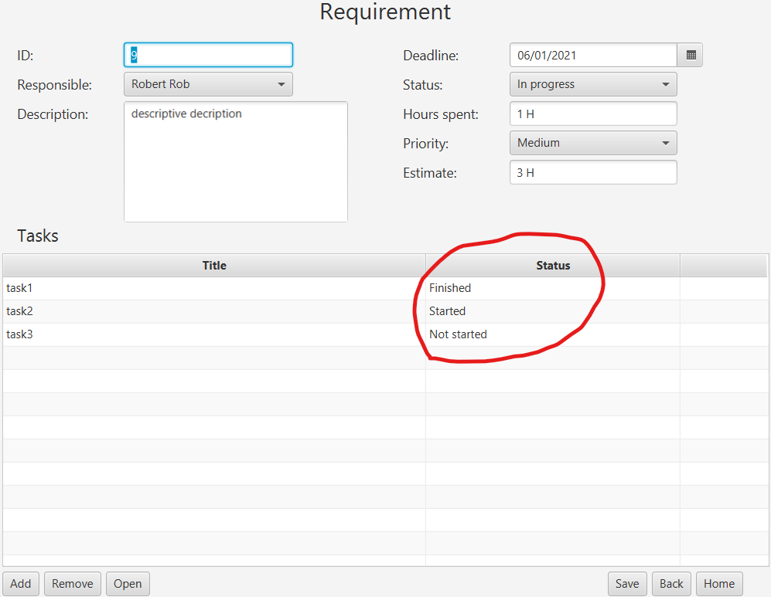
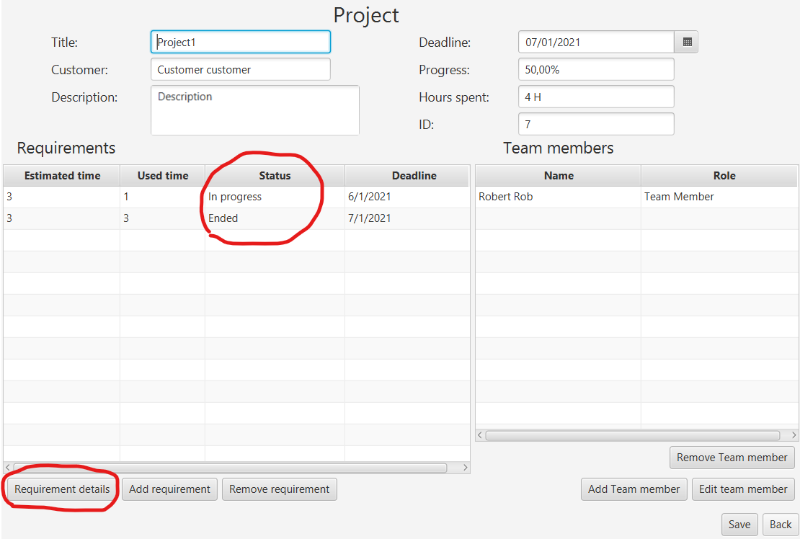
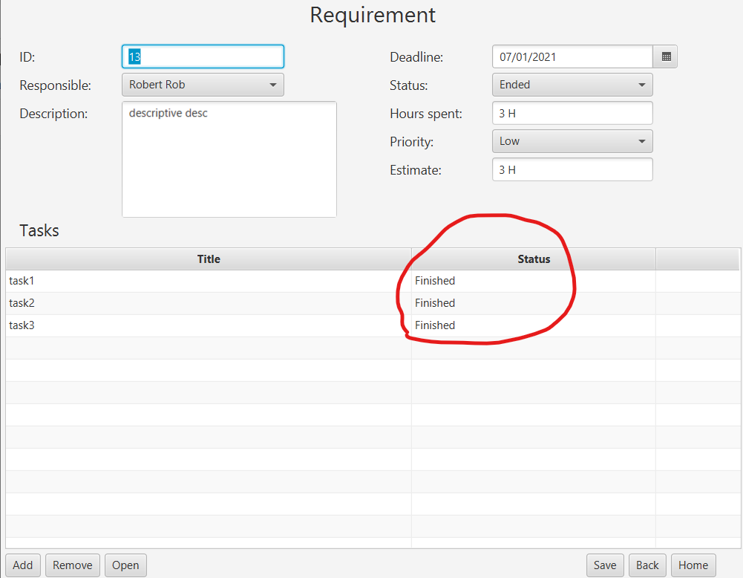
Design - GUI screenshot
Fig 7. New GUI project and requirement views

Slide 14
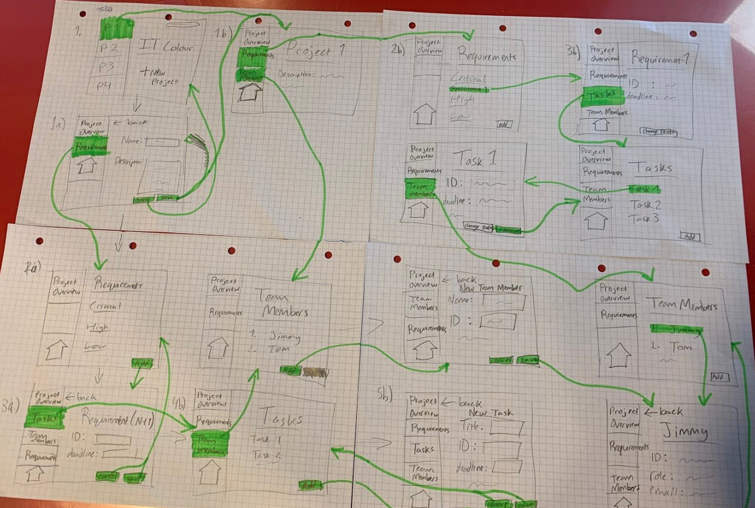
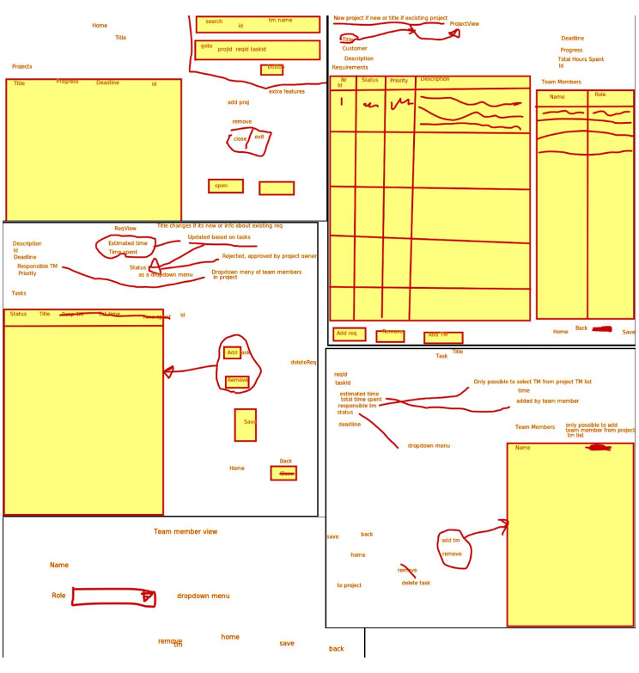
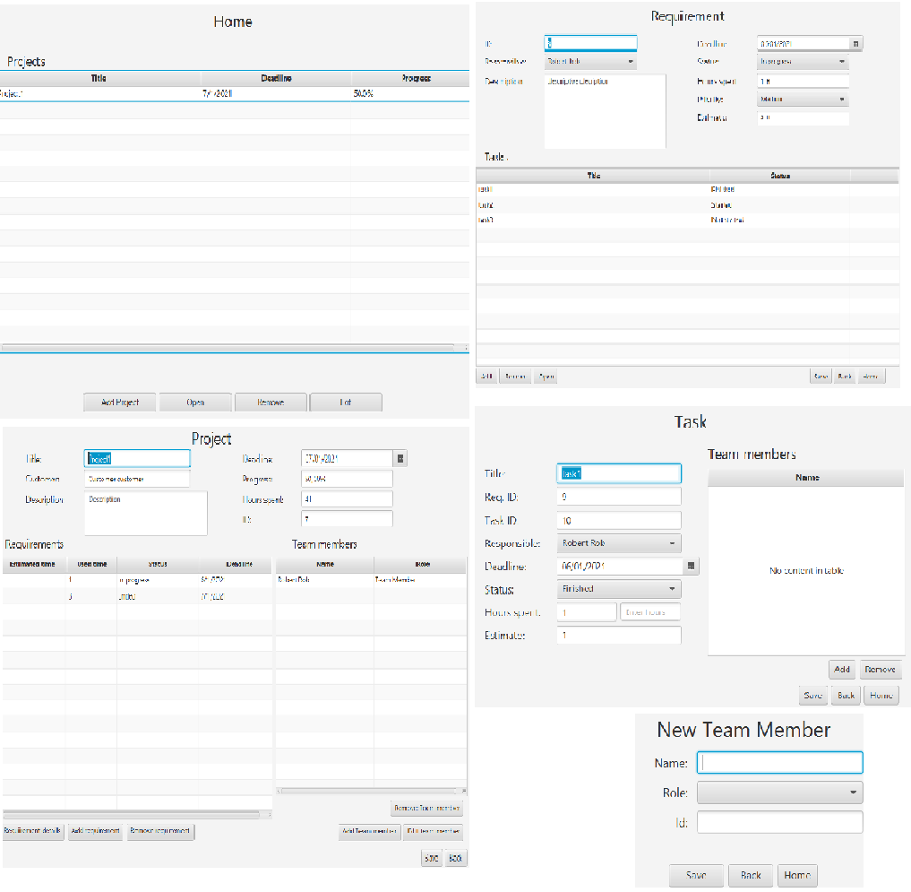
Design - GUI views
Fig 8. Old vs New GUI

Slide 15
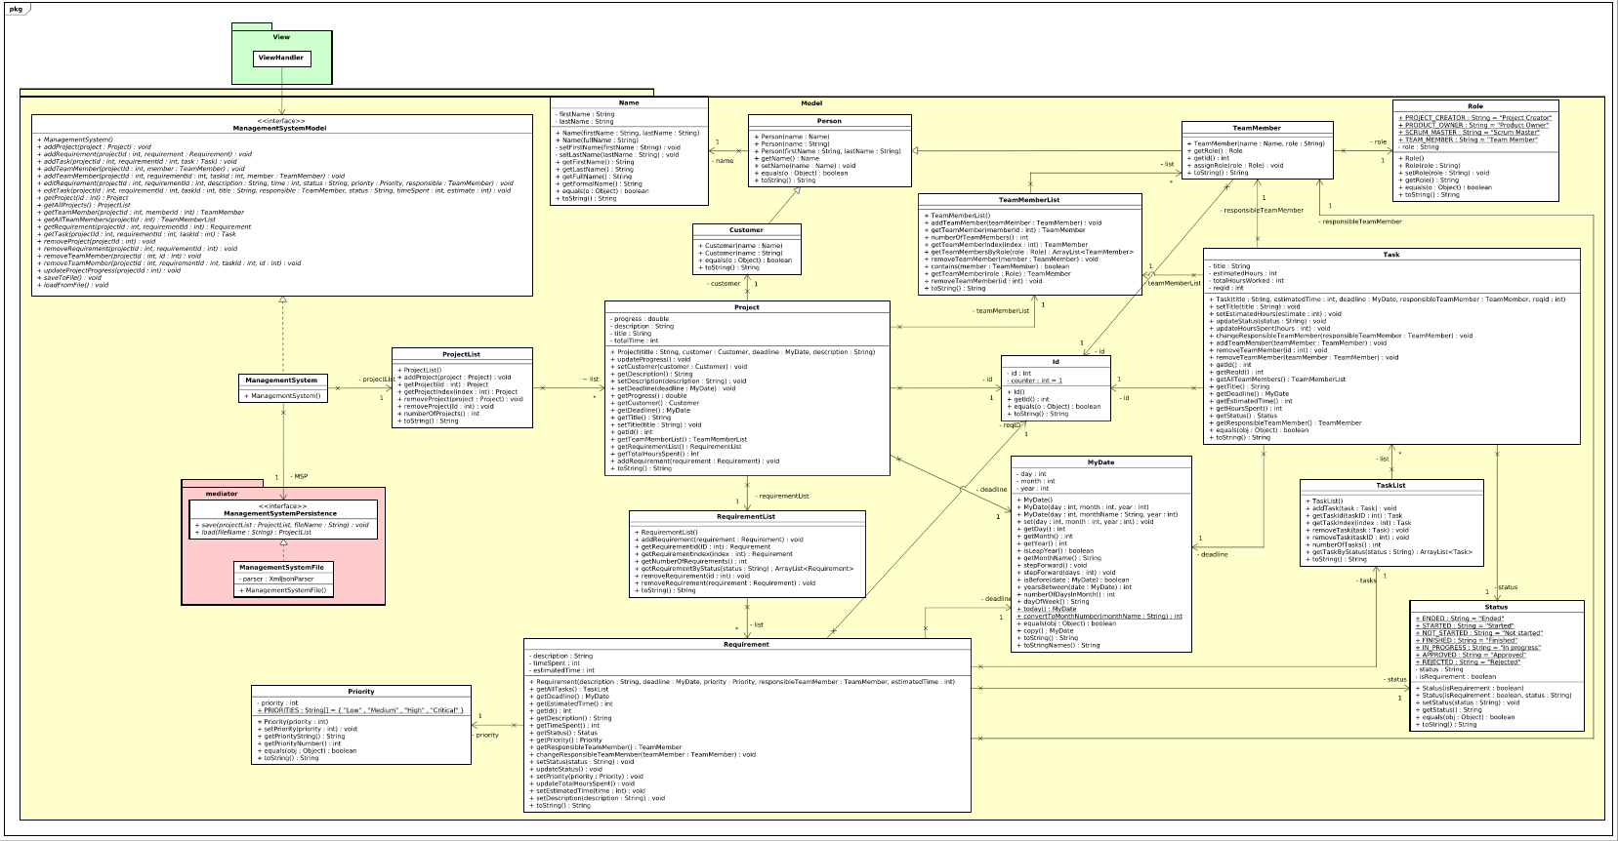
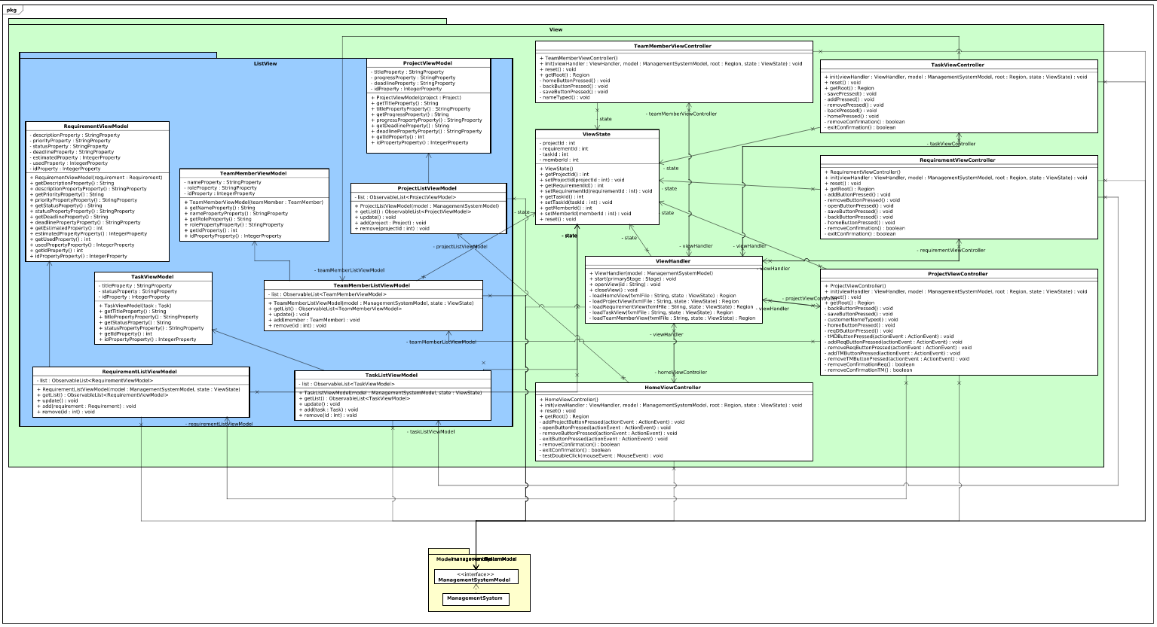
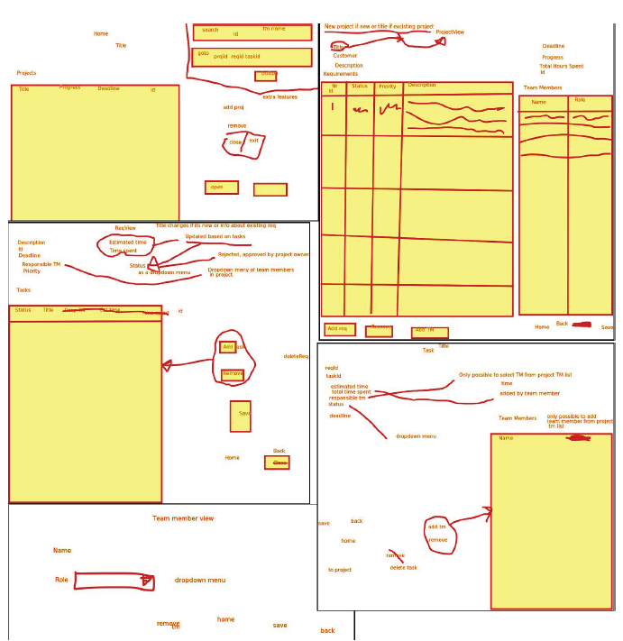


Implementation
Based on design
Version control
Waterfall

Slide 16
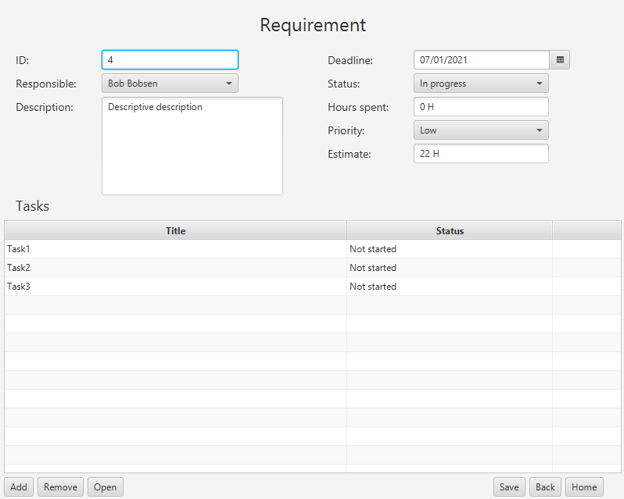
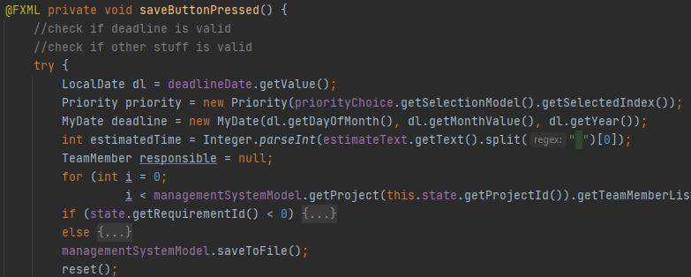
Implementation - Requirement 9
Gui
Functionality
States
Persistence

Slide 17
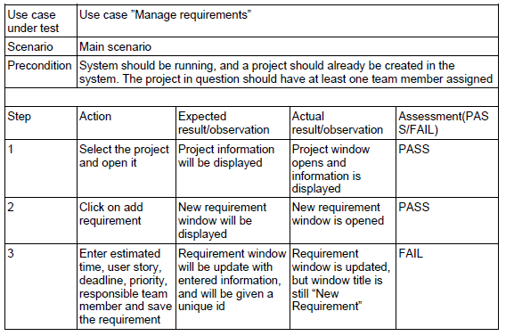
Testing
Test cases
Exception test cases
JUnit tests

Slide 18
Results
What works:
Persistence
Requirements functionality
Project progress
What doesn’t work:
Website
Exception handling
Error messages
New task view
Program demo of requirement 9

Slide 19
Conclusion

Slide 20
Future implications
Website for the system (requirement 20.)
Search function (requirement 18.)
Make better class diagram, which would include proper relationships between the classes
Creation date for project, requirement and tasks
Date when the work was started on project, requirement or task
Backup file
Separate file for each project. Maybe even each list. (requirement list, task list, team member list)
Methods should be tested and throw exceptions based on the wrong input

Slide 21


